Slide 1

SURF national research cloud
Supporting cooperation in research

Slide 2
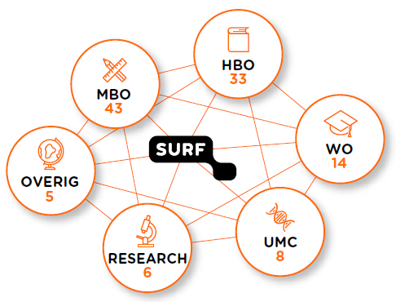

SURF is the collaborative ICT organisation for Dutch education and research.
Network infrastructure
FIAM
ICT procurement
Dutch National Super Computer
GRID
Private and Public Clouds
Data Archive
Etc.
Grants or contracts
Notes:
SURF is een coöperatie met ruim 100 leden.
Dit zijn alle Nederlandse universiteiten en umc’s, de meeste hbo- en mbo-instellingen en diverse onderzoeksinstituten waaronder NWO en KNAW.
Access to infra via grants

Slide 3




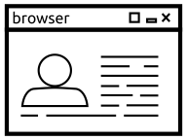


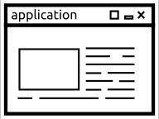
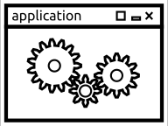

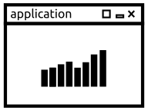



SURF Research Cloud
SURF Research Cloud provides a National Self Service Hub, a platform and a portal, for a broad range of services which enables the collaborative working in a federated and secure manner to accelerate research.
It’s a SURF innovation project, currently in the pilot phase.
(Ad-hoc)
Collaborative
Organization
Collaborative
Research
Environment
Computing &
Storage
Resources

Slide 4



Cloud service models
IAAS
Infrastructure as a Service
Basic components, self managed
General:
Virtual Machines
Also:
Relational databases
Serverless
Kubernetes, Docker, Terraform
SURF HPC cloud and Kubernetes
PAAS
Platform as a Service
Targeted to developers:
Elastic Beanstalk @ AWS
Azure Web Apps & Container Service @ Microsoft
API framework @ SURF Research Cloud
SAAS
Software as a Service
Managed applications and services:
machine learning services @ major cloud providers
AWS Marketplace
TraIT / Elixir services:
Galaxy, BIOS VM
Applications and workspaces in SURF Research Cloud

Slide 5




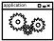

Functional overview Research Cloud
Funding request
Collaborative
Organization
Research Cloud
Federated
Identity & Acces
Management
Portal
WebUI
SURF Managed services
Research
Workspace
SCZ
Community Managed services
API
Unmanaged services
Budgetting
& Accounting
Shared Filesystem
CBA
Reporting
Catalog
ResearchDrive
Controler
Data
Integration
RDM
Research
Environment
Infrastructure
iRODS
Provider
Provider
Institutional
Providers
HPC Cloud
Cumulus
Public Clouds

Slide 6
PAAS in Research Cloud
Target: Research supporter, scientific programmers
Framework components:
FAIR Data integration
Federated identity access management
RDM link
Provisioning with version tracking
Service management, support
Security, privacy and compliancy
Accounting, reporting, billing, auditability
Make available SAAS, applications marketplace
PAAS
SAAS
Research
Cloud
IAAS

Slide 7
SAAS in Research Cloud
PAAS
SAAS
Research
Cloud
Target: researchers, data stewards
Offered:
SURF services
ResearchDrive, Jupyter Hub
General opensource service
R-Studio, Jupyter notebook, PSPP
Community applications
BIOS VM, XNAT ViewR
Licensed applications (planned)
With the advantages of our PAAS
IAAS
Windows / linux
Management and support models:
SURF managed
TRAIT / Research Support model
Institute / research group managed

Slide 8
Workflow SURF Research Cloud
Research supporter
Catalog of applications
Infrastructure
eg.
- Azure - HPC Cloud - Institute?
But which applications?
Runs on
Chooses
Researcher
The community knows and has these!
Is available in
Catalog of datasets
And which datasets?
Chooses
Pre-configured Workspace
Notes:
Community effort, but no community expertise (5 pillars!)
bijv. Galaxy docker image = nightmare!

Slide 9
Pilot version MVP
Applications
SURFsara managed
Jupyter Notebooks
R-Studio
…
Community managed
ViewR / XNAT
BBMRI – BIOS VM
SPOT (NL eScience Center)
…
Environments
Windows
Ubuntu
Linked clouds
3 public clouds
(AWS, Azure, Exoscale)
SURF HPC Cloud
EMBL- EBI embassy cloud
Key features
FIAM: SURFconext – SCZ
SURF ResearchDrive integration
Dataset connections
ECMWF (weather data), BIOS GO NL, Susivis

Slide 10
Sharing data and results within Research Cloud
Your workspace, accessible only by you
Group workspace, accessible by a subset of a collaborative organization
Collaborative Organization (CO) workspace, accessible by the whole collaborative organization
So, a CO could be used to share a benchmark dataset
Within a Group you can access this data to develop algorithms together
Or you can work privately in your own workspace
Your Workspace
CO workspace
Group workspace

Slide 11



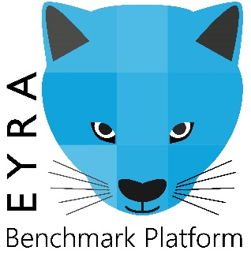



Participate in EYRA via the ResearchCloud
Public Clouds,
SURF HPC Cloud,
Community clouds
training data
EYRA Platform
training data
ResearchCloud
results
results
local cluster
Own development
collaborating developer
instititute Y
instititute X

Slide 12
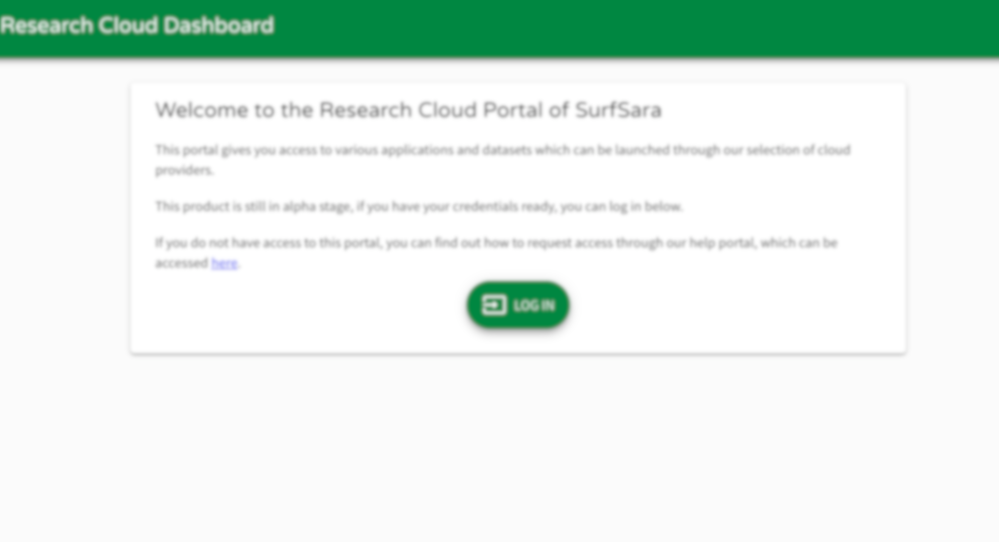
DEMO by NLeSC
Roel & Evelien
Notes:
Roel & Evelien

